Slide 1
LAB 2 WHAT IF YOU DID NOT HAVE LABELS FOR YOUR DATASET ?

Slide 2
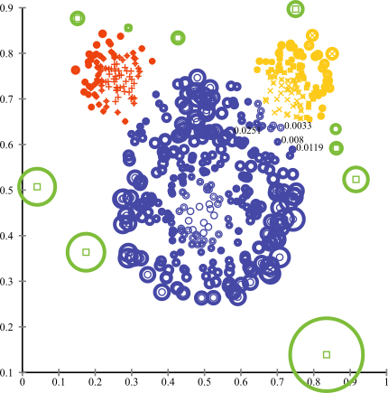
UNSUPERVISED DETECTION METHODS
Statistical, proximity, and deviation
Statistical methods assume that the data can be modeled from a specific distribution
Anomalous if probability is less than threshold
Proximity methods use distance to define anomalies
Anomalous if distance from centroid greater than threshold
Deviation methods use lower-dimensional embeddings and reconstruction error
Anomalous if reconstruction error is greater than one or standard deviations
https://stats.stackexchange.com/questions/160260/anomaly-detection-based-on-clustering

Slide 3
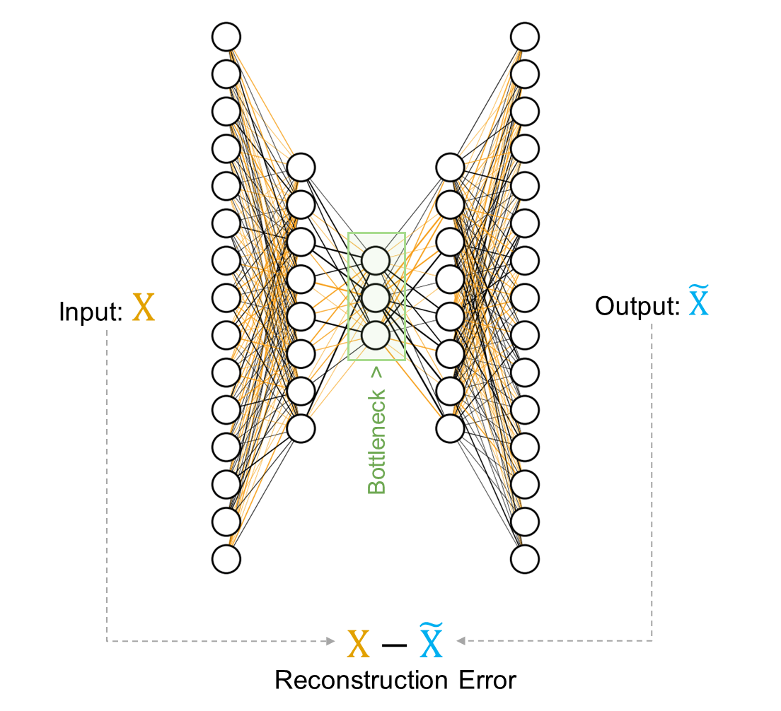
AUTOENCODERS
Deviation based anomaly detection method
Autoencoders are a form of unsupervised learning and have applications outside of anomaly detection
An autoencoder consists of two parts the encoder and decoder
Encoder is a neural network that maps the input to a (typically) lower-dimensional space
Decoder is a neural network that maps the encoded data back to the input
Anomalies have high reconstruction error

Slide 4
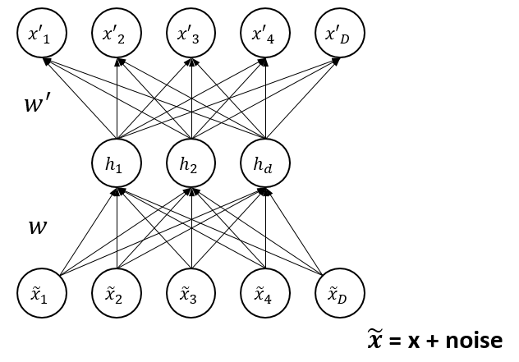
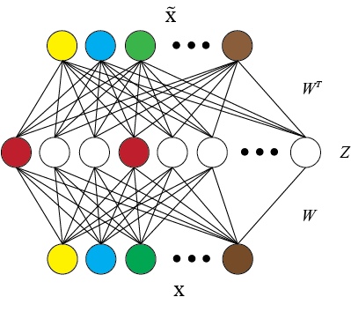
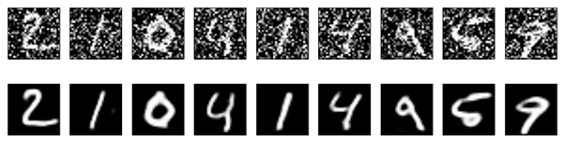
AUTOENCODER FLAVORS
Denoising
Sparse
https://medium.com/@venkatakrishna.jonnalagadda/sparse-stacked-and-variational-autoencoder-efe5bfe73b64
https://blog.keras.io/building-autoencoders-in-keras.html

Slide 5
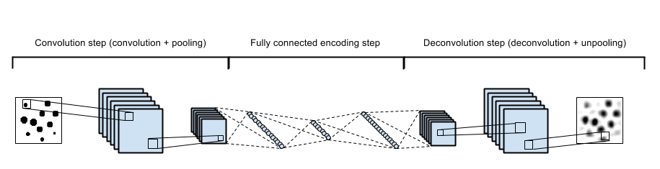
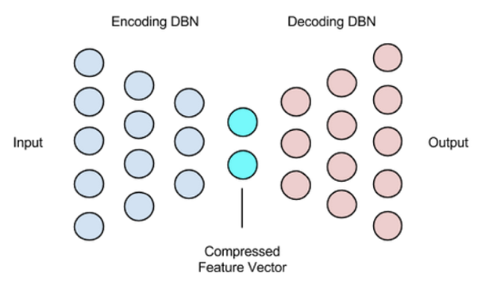
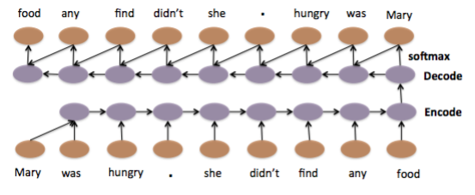
MODULARITY
Convolutional
Deep
https://swarbrickjones.wordpress.com/2015/04/29/convolutional-autoencoders-in-pythontheanolasagne/
LSTM
https://deeplearning4j.org/deepautoencoder
https://arxiv.org/pdf/1506.01057v2.pdf

Slide 6
DEEP AUTOENCODERS

Slide 7
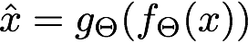
Autoencoder based Anomaly Detection
Input
Data
Reconstructed
Data
Encoder-Net
Decoder-Net
duration | 0
src_bytes | 215
service | http (1)
flag | SF (1)
src_bytes | 215
. . .
dst_host_srv_rerror_rate | 0
x₁
_{Y1}
duration | 0
src_bytes | 215
service | http (1)
flag | SF (0)
src_bytes | 215
. . .
dst_host_srv_rerror_rate | 1
✔
x₂
.
.
.
.
.
.
_{Y2}
✔
x₃
.
.
.
.
.
.
_{Y3}
✔
x₄
.
_{Y4}
✖
.
.
.
.
.
.
.
.
✔
.
.
.
.
.
.
_{Y5}
x₅
.
.
.
.
.
.
.
.
.
.
.
.
.
.
.
.
.
.
.
.
.
.
.
.
.
.
.
.
x_{i}
_{Yi}
✖

Slide 8
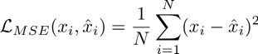
AUTOENCODER RECONSTRUCTION ERROR
Input Data
Encoder-Net
Decoder-Net
Reconstructed Data
✔
duration | 0
src_bytes | 215
service | http (1)
flag | SF (1)
src_bytes | 215
. . .
dst_host_srv_rerror_rate | 0
x₁
x₁
duration | 0
src_bytes | 215
service | http (1)
flag | SF (0)
src_bytes | 215
. . .
dst_host_srv_rerror_rate | 1
✔
x₂
.
.
.
.
.
.
x₂
✔
x₃
.
.
.
.
.
.
x₃
✖
x₄
.
x₄
✔
.
.
.
.
.
.
.
.
x₅
.
.
.
.
.
.
x₅
.
.
.
.
.
.
.
.
.
.
.
.
.
.
.
.
.
.
.
.
.
.
.
.
.
.
.
.
.
x_{i}
✖
x_{i}
Reconstruction Error
x_{i}
Mean-Squared Error (MSE)
x_{i}

Slide 9
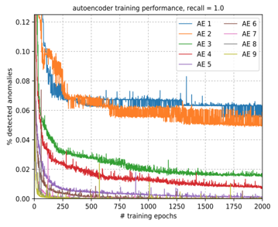
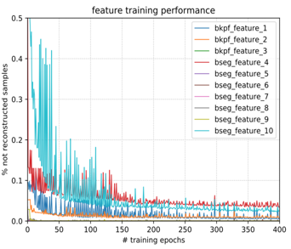
AUTOENCODER RECONSTRUCTION ERROR
Input
Journal Entry
Encoder-Net
Decoder-Net
Reconstructed
Journal Entry
✔
duration | 0
src_bytes | 215
service | http (1)
flag | SF (1)
src_bytes | 215
. . .
dst_host_srv_rerror_rate | 0
x₁
x₁
duration | 0
src_bytes | 215
service | http (1)
flag | SF (0)
src_bytes | 215
. . .
dst_host_srv_rerror_rate | 1
✔
x₂
.
.
.
.
.
.
x₂
✔
x₃
.
.
.
.
.
.
x₃
✖
x₄
.
x₄
✔
.
.
.
.
.
.
.
.
x₅
.
.
.
.
.
.
x₅
.
.
.
.
.
.
.
.
.
.
.
.
.
.
.
.
.
.
.
.
.
.
.
.
.
.
.
.
.
x_{i}
✖
x_{i}
Reconstruction Error – Training Performance
x_{i}
x_{i}

Slide 10
RECONSTRUCTION ERROR OF REGULAR SAMPLE
Encoder-Net
Decoder-Net
x₁
0.0
0.0
1.0
0.0
0.0
…
0.0
0.02
-0.01
1.11
0.0
0.08
…
0.05
x₁
x₂
.
.
.
.
.
.
x₂
z₁
Reconstruction error of a single sample
x₃
.
.
.
.
.
.
x₃
z₂
.
x₄
.
.
.
.
.
.
.
x₄
0.0215
.
.
.
.
.
.
.
x₅
.
.
x₅
.
.
z_{n}
.
.
.
.
.
.
.
.
.
.
.
.
.
.
.
.
.
.
.
.
.
.
.
.
.
x_{i}
x_{i}

Slide 11
RECONSTRUCTION ERROR OF AN ANOMALY
Encoder-Net
Decoder-Net
x₁
0.0
0.0
1.0
0.0
0.0
…
0.0
0.52
0.03
0.01
0.07
-1.08
…
1.45
x₁
x₂
.
.
.
.
.
.
x₂
z₁
Reconstruction error of a single sample
x₃
.
.
.
.
.
.
x₃
z₂
.
x₄
.
.
.
.
.
.
.
x₄
4.5252
.
.
.
.
.
.
.
x₅
.
.
x₅
.
.
z_{n}
.
.
.
.
.
.
.
.
.
.
.
.
.
.
.
.
.
.
.
.
.
.
.
.
.
x_{i}
x_{i}

Slide 12
CATEGORICAL FEATURES
One-hot encoding vs Entity Embedding
 | X1 | C1 | C2
1 | Xa | C1a | C2a
2 | Xb | C1b | C2a
3 | Xc | C1b | C2c
 | X1 | C1a | C1b | C1c | C2a | C2b | C2c
1 | Xa | 1 | 0 | 0 | 1 | 0 | 0
2 | Xb | 0 | 1 | 0 | 1 | 0 | 0
3 | Xc | 0 | 1 | 0 | 0 | 0 | 1
One-hot encoding
C1 | Embedding
C1a | [0.1,0.2,0]
C1b | [0.5,0.7,0.1]
C2 | Embedding
C2a | [-0.5,0.2,0.4]
C2c | [0.3,0.7,0.8]
 | X1 | C11 | C12 | C13 | C21 | C22 | C23
1 | Xa | 0.1 | 0.2 | 0 | -0.5 | 0.2 | 0.4
2 | Xb | 0.5 | 0.7 | 0.1 | -0.5 | 0.2 | 0.4
3 | Xc | 0.5 | 0.7 | 0.1 | 0.3 | 0.7 | 0.8
,
Entity Embedding

Slide 13
EMBEDDING CATEGORICAL FEATURES
Dense Layer 1
Embedding Layer
 | X1 | C1 | C2
1 | Xa | C1a | C2a
2 | Xb | C1b | C2b
3 | Xc | C1c | C2c
Output
Layer
X = Continuous Variable
C = Categorical Variable
Input layer
Flatten
Concat Layer
Dense Layer 2

Slide 14
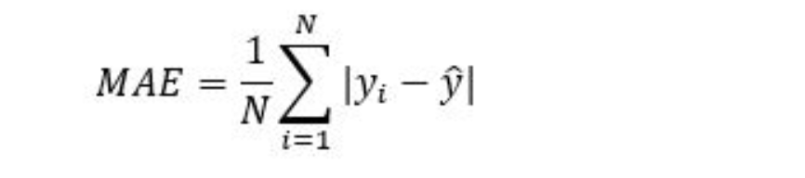
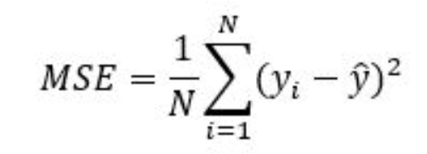
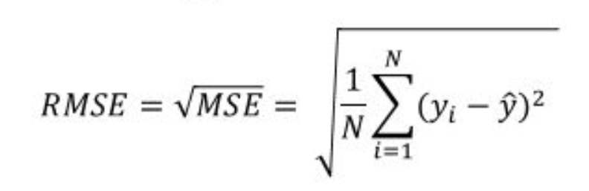
ERROR METRICS
Comparing the different Metrics
Mean Absolute Error (MAE): This measures the absolute average distance between the real data and the predicted data, but it fails to punish large errors in prediction.
Mean Square Error (MSE): This measures the squared average distance between the real data and the predicted data. Here, larger errors are well noted (better than MAE). But the disadvantage is that it also squares up the units of data as well. So, evaluation with different units is not at all justified.
Root Mean Squared Error (RMSE): This is actually the square root of MSE. Also, this metrics solves the problem of squaring the units.

Slide 15
Auto-Encoder on Time-series Data
Bonus
x N
Time | Feature 1 | Feature 2 | Feature 3
00:00:00 | Val_1 | Val_2 | Val_3
00:00:01 | Val_4 | Val_5 | Val_6
00:00:02 | Val_7 | Val_8 | Val_9
00:00:03 | Val_10 | Val_11 | Val_12
Time | Feature 1 | Feature 2 | Feature 3
00:00:00 | Val_1_1 | Val_2_2 | Val_3_3
00:00:01 | Val_4_4 | Val_5_5 | Val_6_6
00:00:02 | Val_7_7 | Val_8_8 | Val_9_9
00:00:03 | Val_10_10 | Val_11_11 | Val_12_12
.
.
.
.
.
.
.
.
.
.
.
Reconstruction Error – Training Performance
.
.
.
.
.
.
.
.

Slide 16
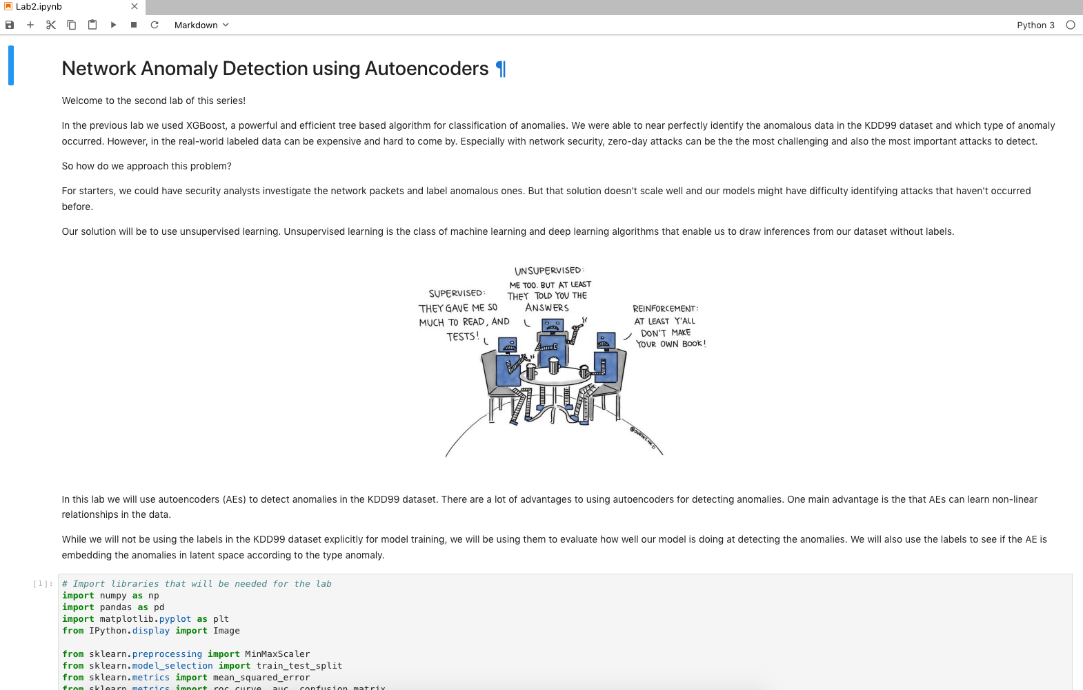
LAB 2 HANDS-ON

Slide 17
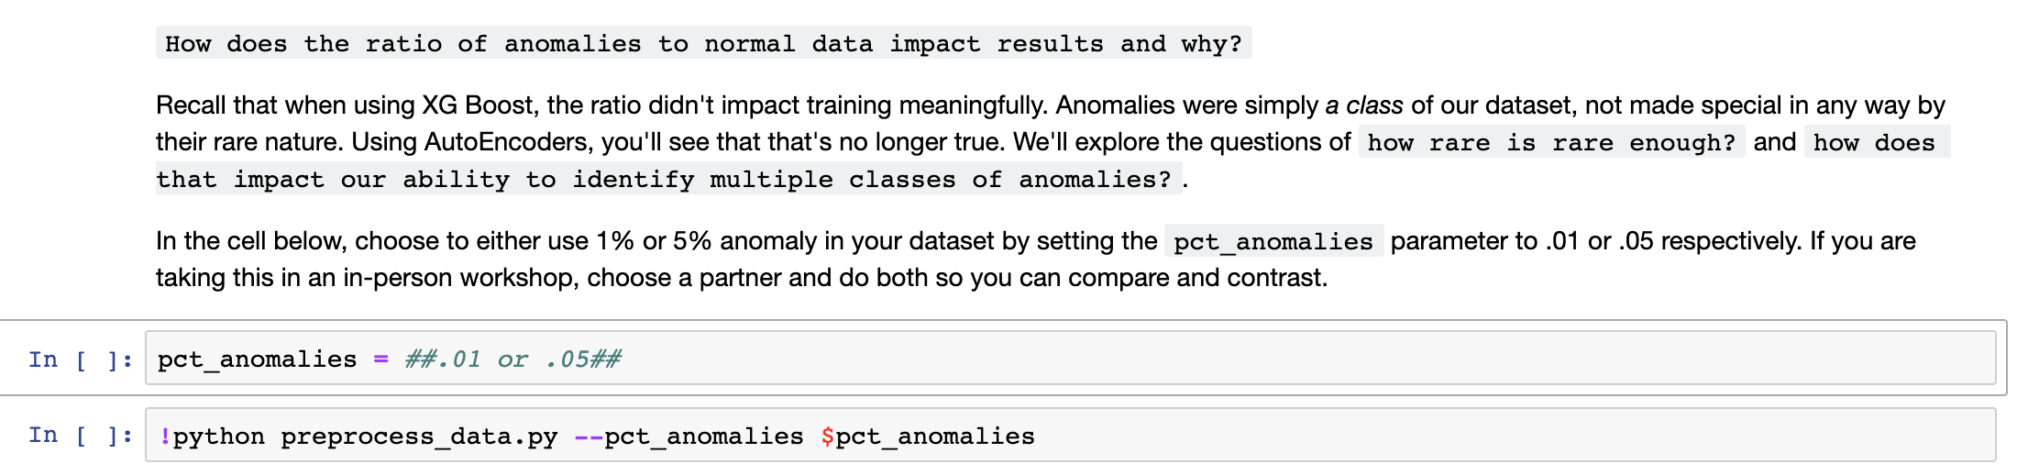
Choose one

Slide 18
THANK YOU!

